Slide 1
Lariat
A rental car company
1-800-555-9345
Presented by Ye Chen (Jason)
12.11.2020

Slide 2
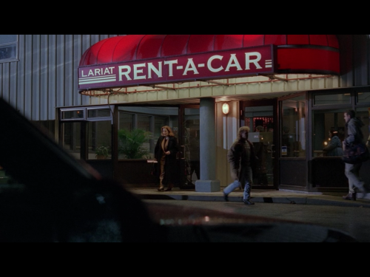
Agenda
The purpose of this project
Data analysis
Summary
Questions

Slide 3
Data Analysis
Lariat performance break down

Slide 4
Data Analysis
Strategy 1: buy 197 of top 10 cars that make the most profit for increasing gross revenue
City and State | Total Revenue
Charlotte,North Carolina | $2,118,694
Denver,Colorado | $2,155,030
El Paso,Texas | $2,147,441
Fort Worth,Texas | $2,150,621
Los Angeles,California | $2,104,927
New York City,New York | $2,073,596
Pomona,California | $1,111,109
Sacramento,California | $2,091,261
Saint Louis,Missouri | $1,111,112
Washington,District of Columbia | $3,187,750
Grand Total | $20,251,541
Cars increase from 4000 to 4197
Gross profit increases by 5%

Slide 5
Data Analysis
Strategy 2: retire 113 of the top 100 car that make the least profit in order to save cost
Car make and model | Gross profit
Daewoo Nubira | ($4,106.92)
Audi 5000CS | ($2,806.80)
Saturn Relay | ($1,296.76)
Plymouth Volare | ($1,120.32)
Dodge D150 Club | ($564.28)
Mercedes-Benz SLS-Class | ($555.64)
Ford Aspire | ($337.76)
Fiat 500 | ($271.24)
Maserati GranTurismo | $1.76
Porsche 914 | $52.60
Audi RS 4 | $112.24
Corbin Sparrow | $131.56
Volvo 850 | $247.28
Pontiac Turbo Firefly | $388.44
Mazda B2600 | $391.80
Dodge Sprinter | $437.16
Hummer H2 | $625.48
Suzuki Forenza | $701.76
Chevrolet Lumina APV | $742.36
GMC Yukon XL | $894.64
Cars decrease from 4000 to 3887
The total cost decrease 3%

Slide 6
Data analysis
Combined Strategy: buy 197 top 10 profitable cars, retire 113 Top 100 the least profitable cars.
Cars increase from 4000 to 4084
Gross Revenue increases 4%
Total Cost increases 1.8%
Total Revenue increases 2.7 %

Slide 7
Overall Data Comparison

Slide 8
Support Data

Slide 9

Summary
With the goal of increasing gross revenue and reducing cost, I have three strategies, one of which combines 1 and 2
Strategy 1
Strategy 2
Combined
Overall conclusion

Slide 10
Thank You
Any questions?

